Slide 1
Lecture 4 CUDA Execution Model II
Kyu Ho Park
Mar. 9, 2017

Slide 2
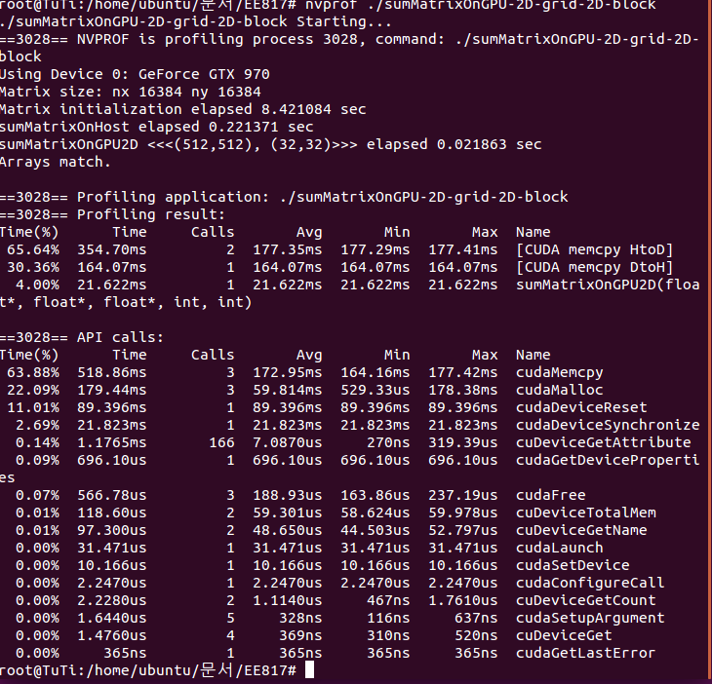

Slide 3
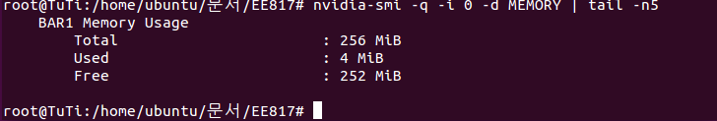
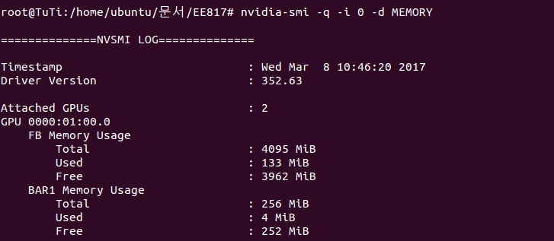
MB 1024*1024byte
MiB 1,000,000byte
KB 1000byte
KiB 1024byte

Slide 4
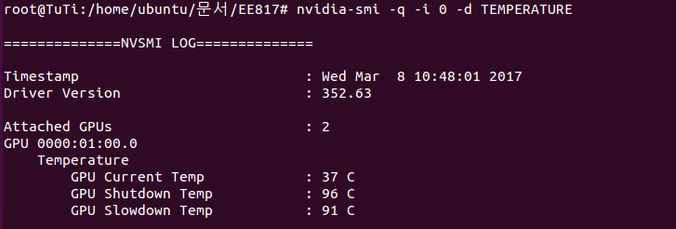
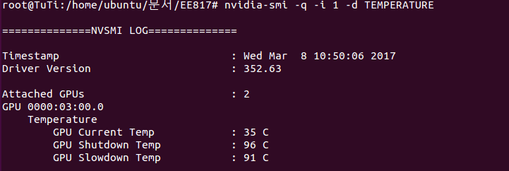

Slide 5
nvidia-smi
nvidia-smi command reports the following:
MEMORY
UTILIZATION
ECC
TEMPERATURE
POWER
CLOCK
COMPUTE
PIDs
Performance etc.

Slide 6
Thread-Block-Grid & Core-SM-Device
Software
Hardware
Thread
CUDA core
SM
Block
Device
….
Grid

Slide 7
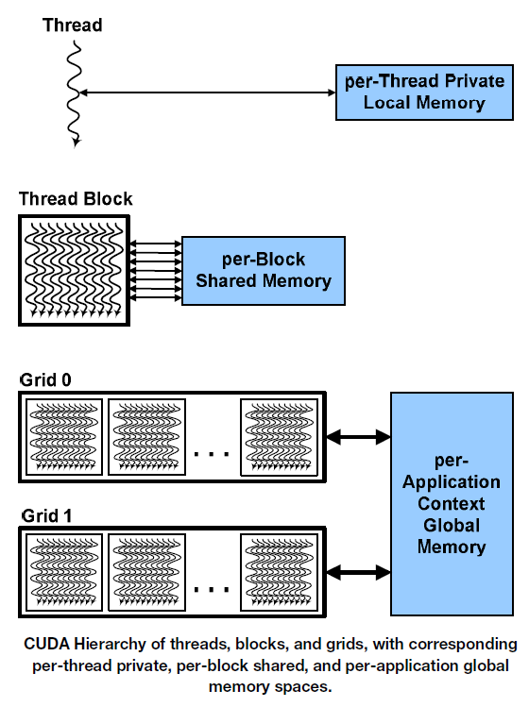
CUDA Execution Model

Slide 8
Local Memory
Local memory does not physically exist. Actually automatic array variables are put in the global memory by the compiler.
Automatic variables other than arrays:
Put in Register, Scope: Thread, Lifetime: Kernel
Automatic array variables:
Put in local memory, Scope: Thread, Lifetime: Kernel

Slide 9
Automatic Variable
Automatic variable is a local variable which is allocated and deallocated automatically when program flow enters and leaves the variable scope.
Example:
int function(void)
{
int a;
static b;
------
}

Slide 10
Host
Device
One grid execution at a time on a device.
Different kernels may have different grid structures.
Kernel
function0
Grid 0
Block
Block
스레드
스레드
Block
Block
CUDA
Execution
Flow
스레드
스레드
Kernel
function1
Grid 1
Block
스레드
Block
스레드
Block
스레드

Slide 11
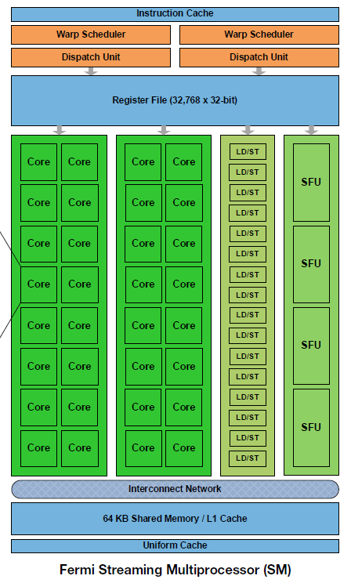
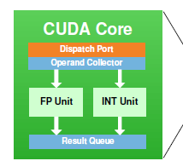
Fermi SM
Two warp schedulers!

Slide 12
Operations of GPU
When the threads scheduled on an SM, the threads of a block execute only on that SM.
Multiple blocks can be assigned to a SM.
It manages and executes threads in groups of 32 threads, called warp.
The threads in a warp execute the same instruction at the same time.

Slide 13
SIMT vs. SIMD
The SIMT (single instruction multiple threads) has 3 features that SIMD does not have.
Each thread has its own instruction address counter.
Each thread has its own register state.
Each thread may have an independent execution path.

Slide 14
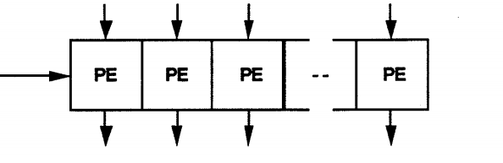
SIMD Architecture
Data
Data
Data
Data
Instruction

Slide 15
Process and Threads
Computer
Computer
Program
counter
Thread
Process
(a)
(b)
Three processes each with one thread.
One process with three threads.

Slide 16
thread execution in a SM
1. A thread block is scheduled on only one SM.
2. An SM can have more than one blocks.
3. Shared Memory is partitioned among thread blocks of the SM.
4. Registers are partitioned among threads.
5. All threads in a block execute logically in parallel, but
physically not all threads execute at the same time.
6.Warps in a thread block may be scheduled in any order. The number of active warps is limited by SM resources.

Slide 17
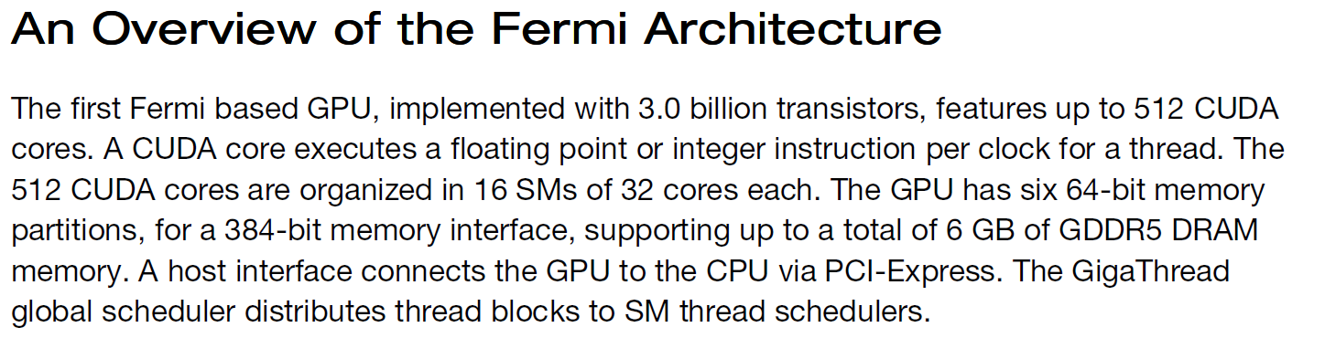
Fermi Architecture

Slide 18
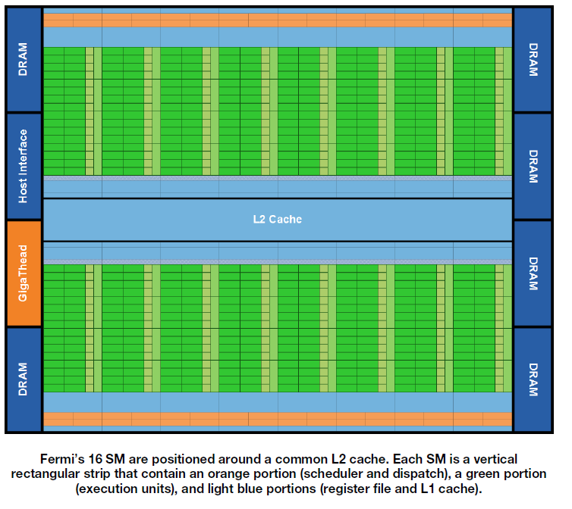
Fermi

Slide 19
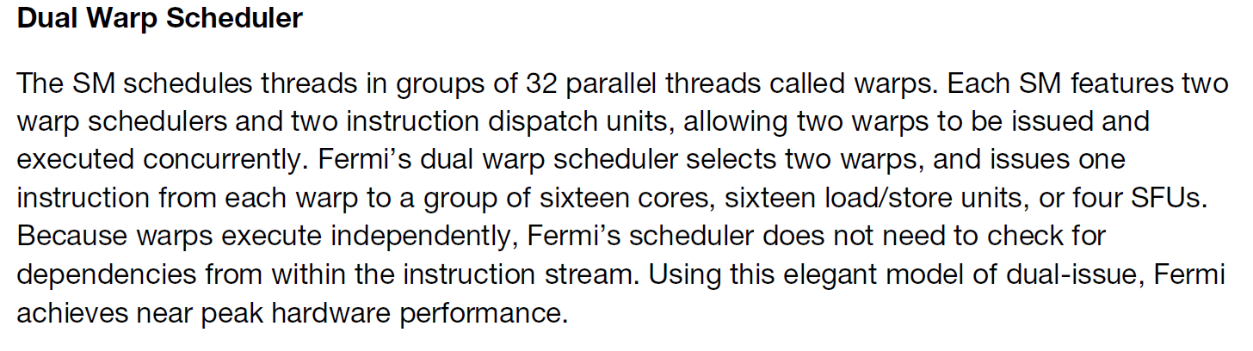
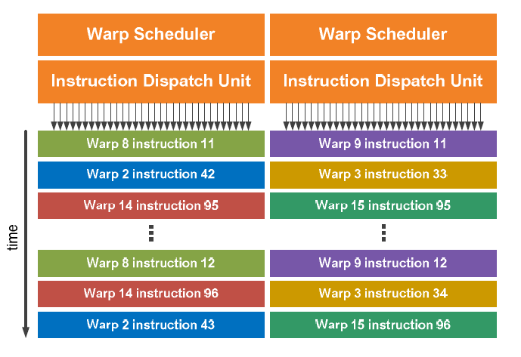

Slide 20
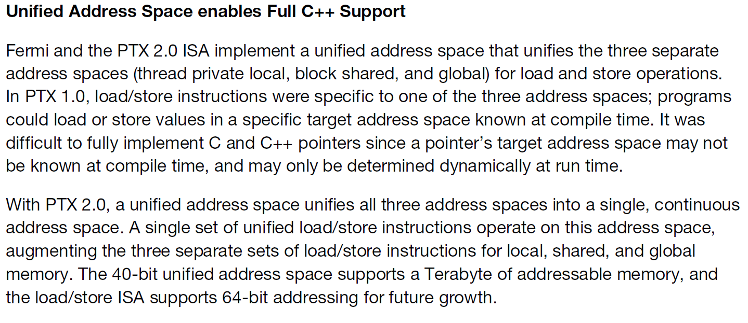
Unified Address Space

Slide 21
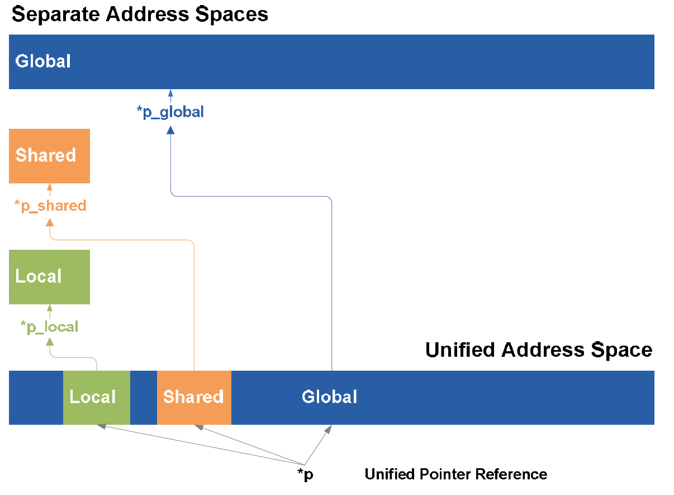
Unified Address Space

Slide 22
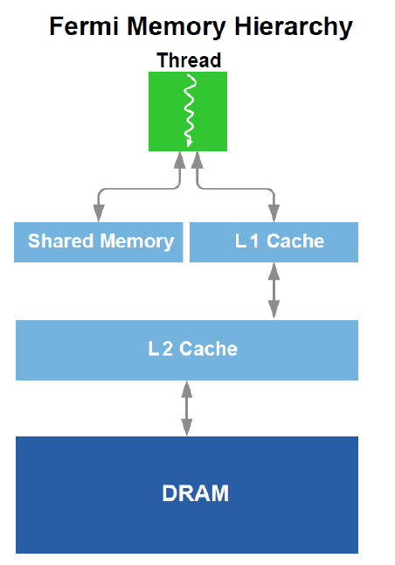
Fermi Memory Hierarchy
global memory

Slide 23
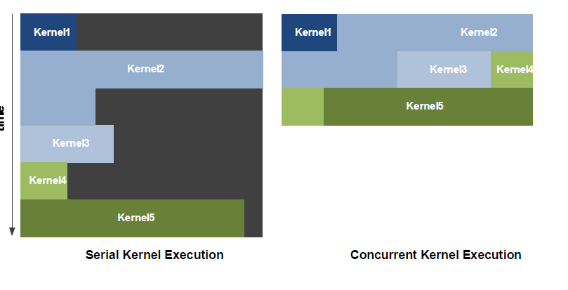
Concurrent Kernel Execution in Fermi
fermi supports concurrent kernel execution: Multiple kernels launched from the same application context executing on the same GPU at the same time.
Fermi allows up to 16 kernels to be run on the device at the same time

Slide 24
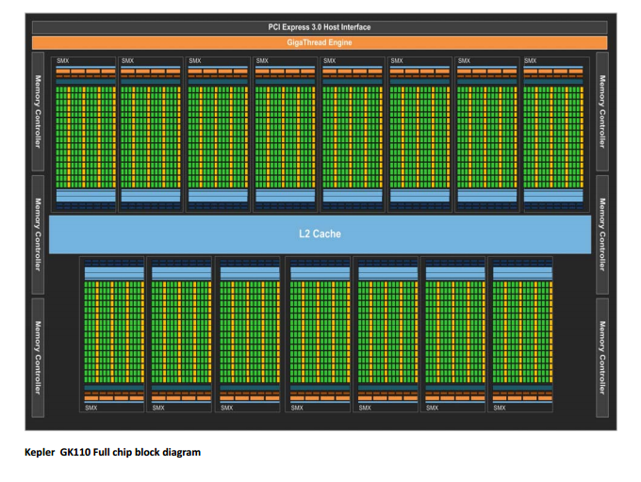
Kepler Architecture

Slide 25
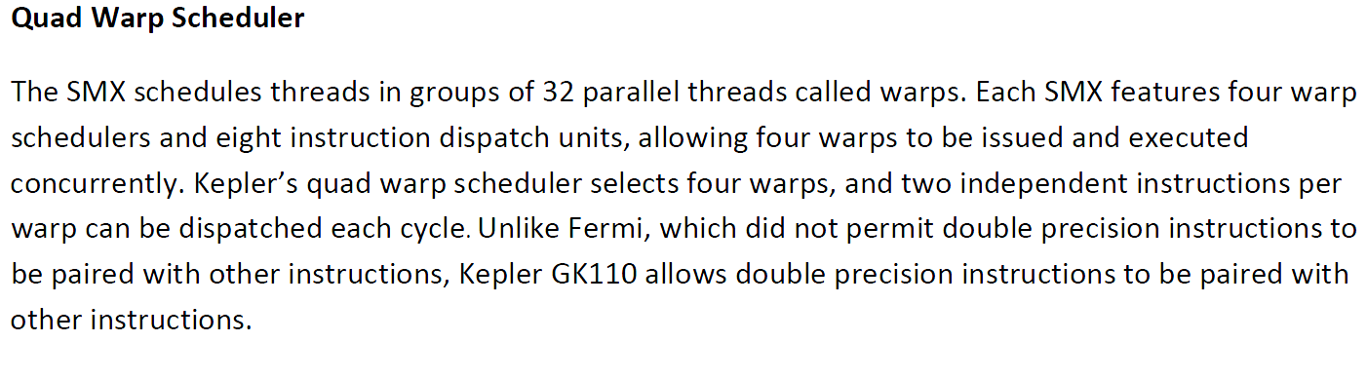
Quad Warp Scheduler

Slide 26
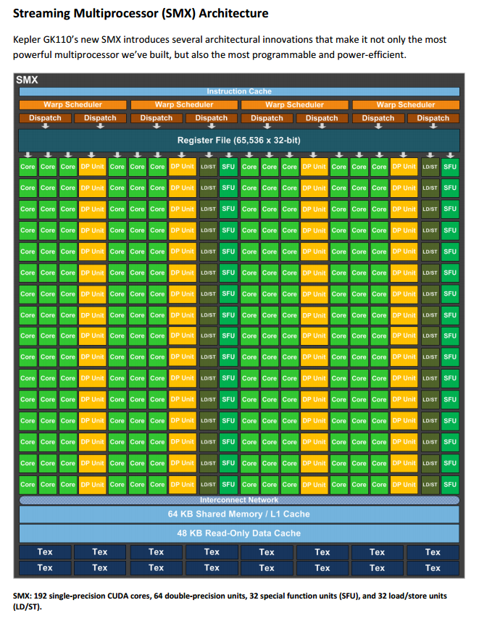
Kepler’s SM

Slide 27
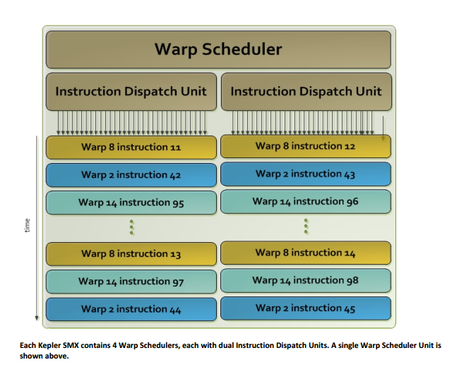
Quad Warp Scheduler

Slide 28
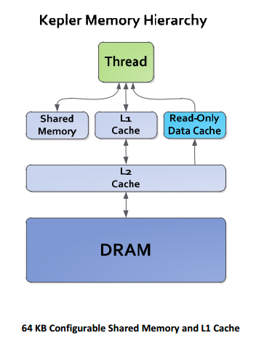
Kepler Memory Hierarchy

Slide 29
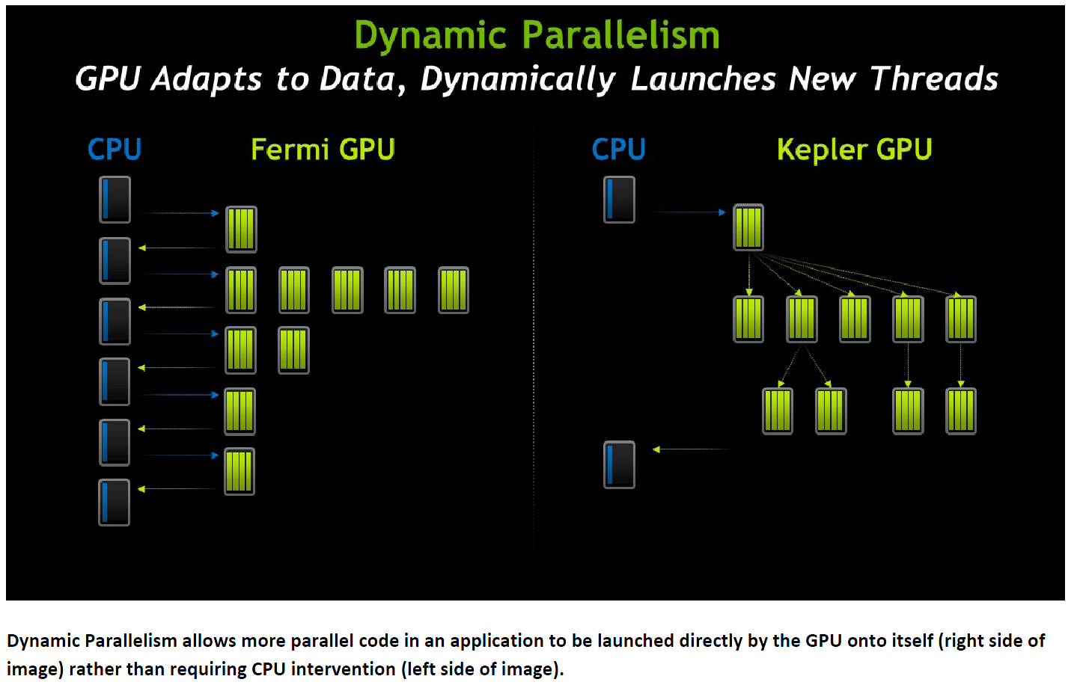
Dynamic Parallelism

Slide 30
Dynamic Parallelism
In Fermi GPU
The Host launches every kernel on GPU
In Kepler GPU
The GPU can launch nested kernels, eliminating the need to communicate with the CPU.

Slide 31
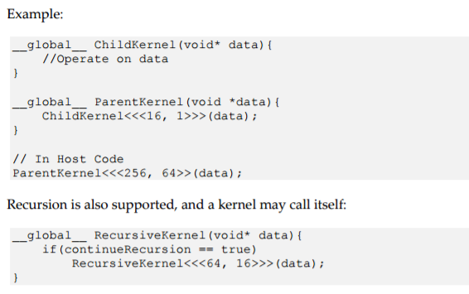
Dynamic Parallelism

Slide 32
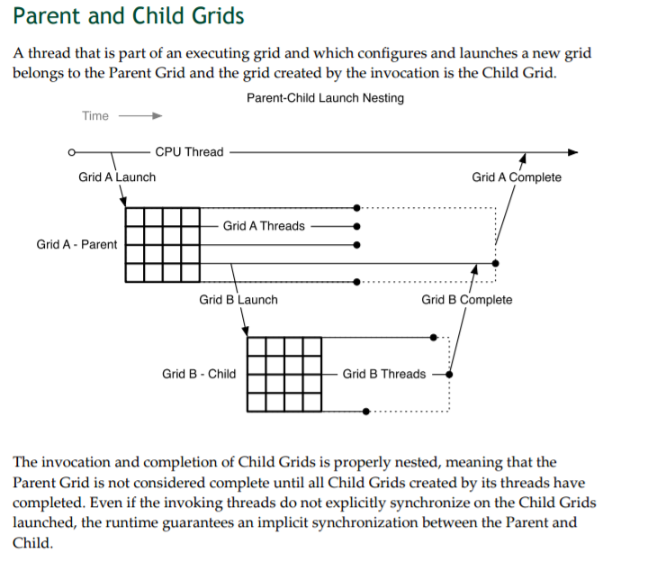

Slide 33
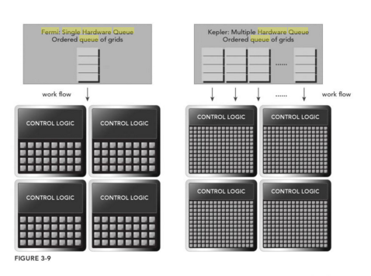
Hyper-Q

Slide 34
Hyper-Q
Fermi GPUs rely on a single hardware work queue to pass tasks from the CPU to the GPU.
Kepler GPUs provide 32 hardware work queues between the host and the GPU.

Slide 35
Warp Execution
Logical View:
All threads in a launched kernel run in parallel at the same time.
In a Real System:
Not all threads can run in parallel at the same time.
Warp: The basic unit of execution in an SM.

Slide 36
Blocks and Warps
A Grid of thread blocks launched and distributed to SMs,
A thread block is scheduled to an SM,
The threads in thread block are partitioned into warps.
A warp consists of 32 consecutive threads and all threads in a warp are executed in SIMT fashion.

Slide 37
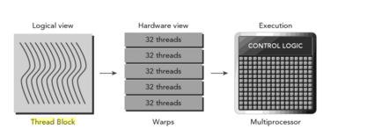
Blocks and Warp Execution

Slide 38
Warps
Thread blocks can be configured to 1D,2D or 3D .
But in the hardware , all threads are arranged in 1D.
Each thread in a block has a unique ID.
Warp 0:thread 0,1,2,…….31
Warp 1: thread 32,33,…..63
Warp 2: thread 64,………95
Warp 3: thread 96,………127
No. of Warps/block =ceil{(Threads/Block)/(Size of a warp)}
A warp is never split between different thread blocks.

Slide 39
Warp Divergence
All threads in a warp must execute identical instructions on the same cycle.
If threads in the same warp take different paths, what will happen?
if( condition) { }
else { }
Warp Divergence : Threads in the same warp executing different instructions.

Slide 40
Threads in a warp divergence
if(condition) then { } else { }
if(condition)
then{ }
else-threads stall
serialization
else{ }
then-threads stall

Slide 41
Warp Divergence
Different conditional values in different warps
do not cause warp divergence.
If it is possible to partition data to ensure all threads in the same warp take the same control path, there would be no warp divergence.

Slide 42
Warp Divergence
__global__ void kernel(int *m)
{
int tid = blockIdx.x*blockDim.x + threadIdx.x;
int k,l;
k=l=0
if (tid%2==0){ k=10; } else { l=20;}
m[tid]=k*l;
}

Slide 43
To Avoid Warp Divergence
__global__ void kernel(int *m)
{
int tid = blockIdx.x*blockDim.x + threadIdx.x;
int k,l;
k=l=0
if ( (tid/warpSize) %2==0){ k=10; } else { l=20;}
m[tid]=k*l;
}
//The even warps take the path of ‘if clause’ and the odd warps take ‘else clause’.

Slide 44
Warps
An active block: when all computing resources have been allocated. The warps in the active block are called active warps.
Active warps
Selected warp,
Stalled warp,
Eligible warp.

Slide 45
Latency Hiding
Latency: The number of clock cycles between an instruction being issued and being completed.
The latency of each instruction can be hidden by issuing other instructions in other warps.
Latency:
arithmetic operations: 10~20 cycles
global memory access: 400~800 cycles

Slide 46
Little’s Law
The long-term average number of customers in a stable system L is equal to the long-term average effective arrival rate, λ, multiplied by the average time a customer spends in the system, W; or expressed algebraically: L = λW.
Number of Required Warps
= Throughput x Latency.

Slide 47
Occupancy
occupancy = active warps/(maximum warps per SM)
To check the maximum warps per SM, use the following function
cudaError_t cudaGetDeviceProperties(struct cudaDeviceProp *prop, int Device);

Slide 48
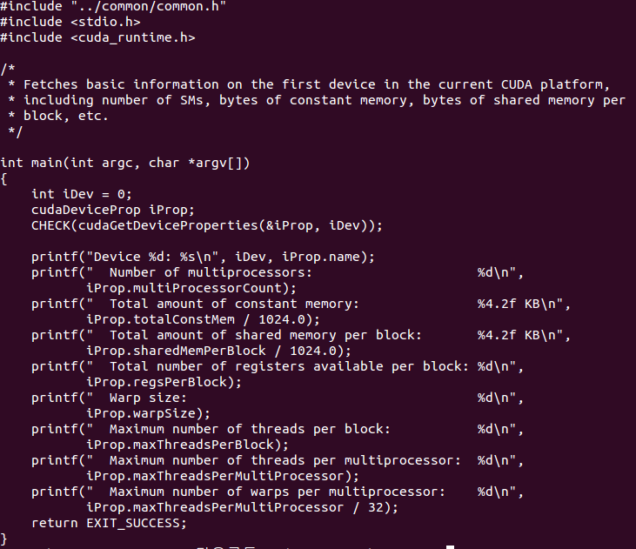
Occupancy

Slide 49
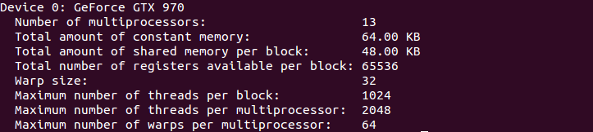
Occupancy

